Slide 1
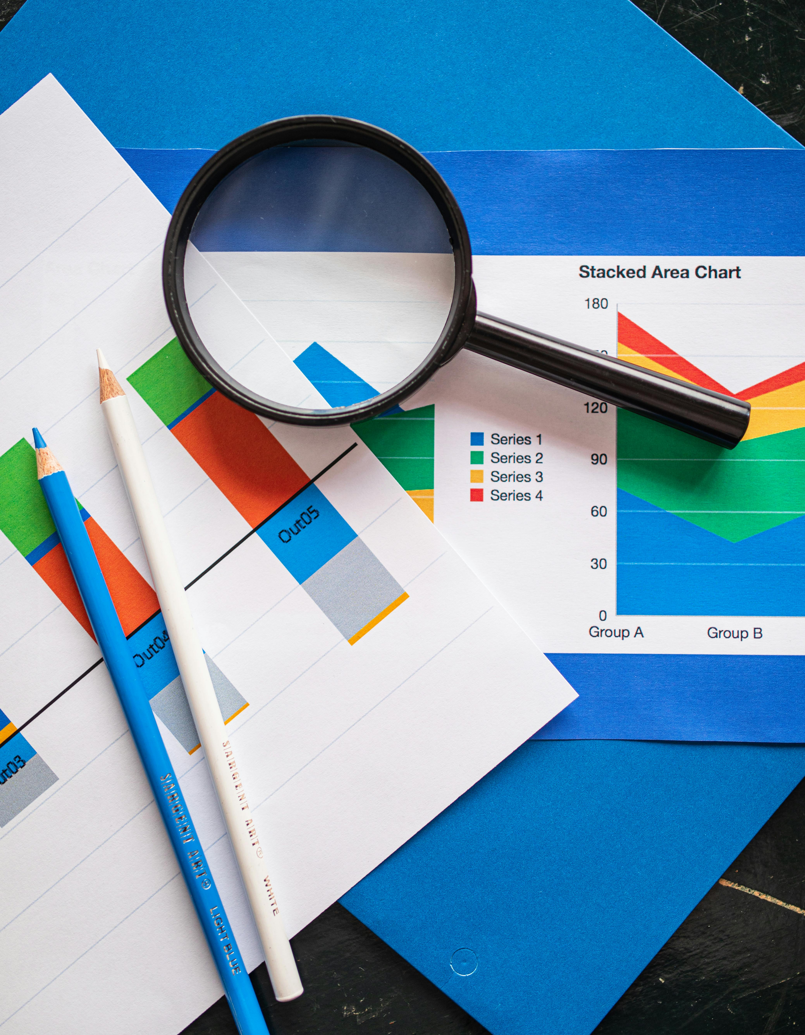
Advertising Campaign Performance Analysis
Tanush Garg

Slide 2
Project Objective
Analyze advertising campaign performance across multiple dimensions
Understand trends in user engagement, conversions, ROI, and CTR
Identify high-performing banners, placements, and campaigns
Provide actionable recommendations for optimization

Slide 3
Dataset Overview
Source: Online advertising performance logs (April - June 2020)
Records: 15,408 campaign instances
Key fields: date, campaign number, user engagement, banner size, publisher space, displays, cost, clicks, revenue, post click conversions, post click sales amount
Format: CSV with 17 columns and various datatypes

Slide 4
Data Preprocessing Steps
Campaign Numbers
Remove “camp” prefix for easier processing
User Engagement Levels
Mapped user engagement levels for easier parsing
Label Encoding
Label encoded banner sizes, placements and months
Handling missing values
Handled the 413 missing placement rows in the data
Removing empty columns
Removed the unnamed auto generated columns for cleaner csv

Slide 5
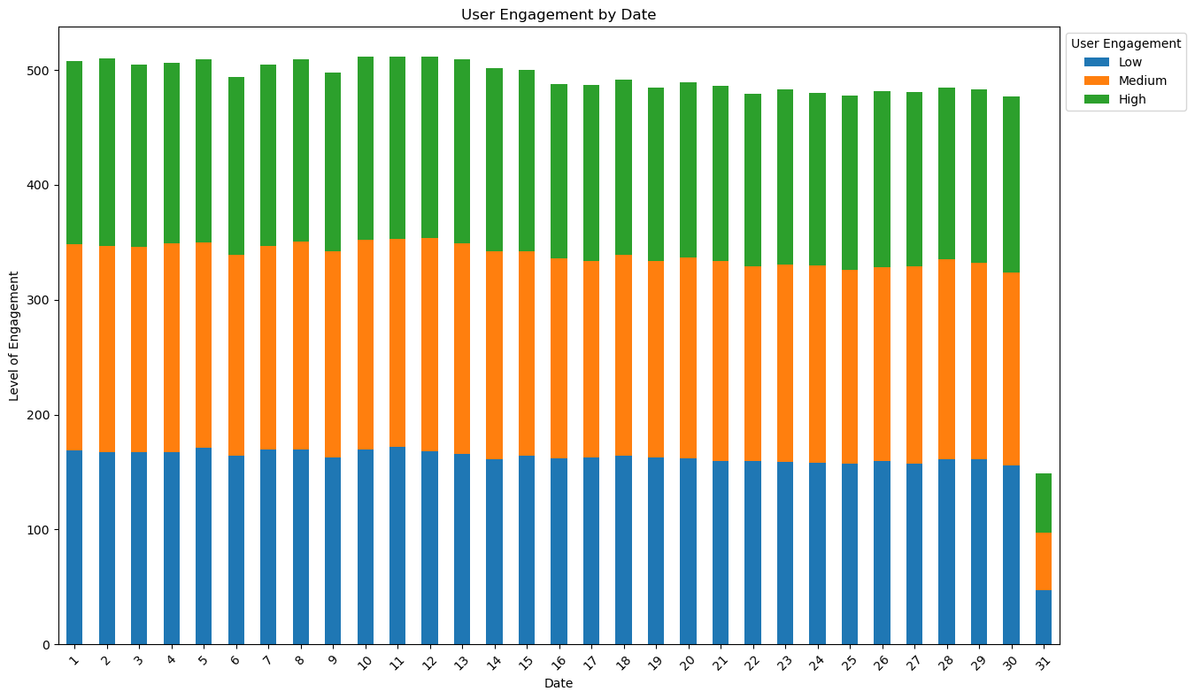
User Engagement by Date
Stacked Bar Graph
Analysis
Key Observation:
The stacked bar chart shows a uniform distribution of user engagement (Low, Medium, High) across most dates from 1 to 30.
Engagement levels remain fairly consistent across all three categories, suggesting a stable user response pattern regardless of the calendar day.
A drop in engagement is observed on Day 31, where the total number of campaigns is significantly lower.
This is expected because:
Day 31 only exists in May.
April and June have 30 days, so Day 31 appears only once in the dataset.

Slide 6
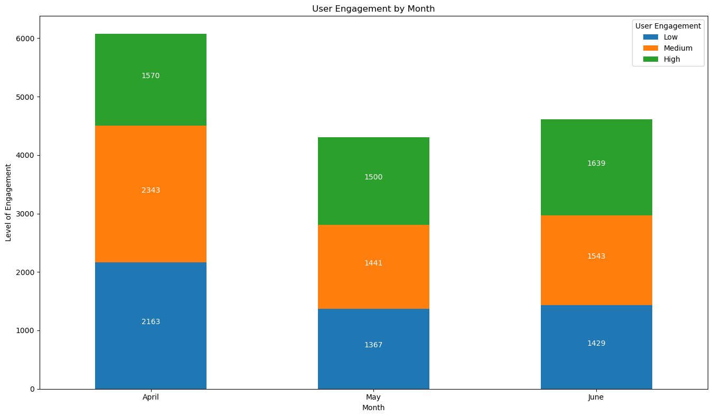
User Engagement by Month
Stacked Bar Graph
Analysis
April dominates across all engagement levels, particularly in Medium engagement, suggesting strong campaign performance or seasonal factors.
May experienced the lowest engagement across all segments, dropping 29% from April, possibly due to seasonal decline, campaign fatigue, or external market factors.
June demonstrated a positive rebound with a 7% increase from May, with High engagement users showing the strongest recovery and even exceeding April's numbers.

Slide 7
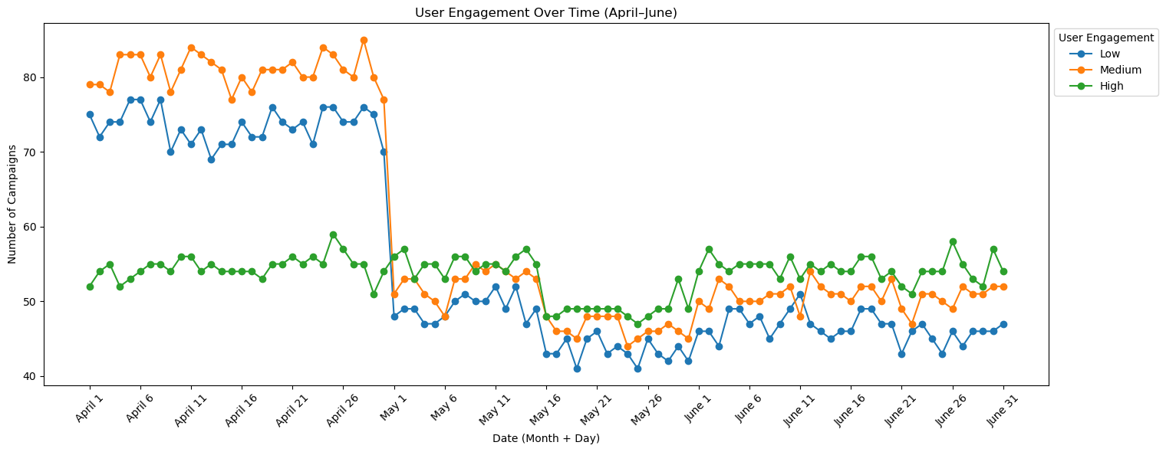
User Engagement Overtime
Line Plot
Analysis
User engagement experienced a significant structural shift at the end of April, with all segments declining 35–45% and stabilizing at new baseline levels through May and June.
Inflection Point: Late April marked a permanent shift in engagement patterns.
Resilience Factor: High engagement users showed minimal impact.
Recovery Signs: June data suggests stabilization rather than continued decline.
New Normal: Baseline established ~30% below April levels.

Slide 8
Recommendations
Investigate the late-April catalyst causing the engagement shift and what drove April's exceptional performance to replicate in future campaigns.
Analyze High segment resilience factors for broader application.
Analyze May's decline to identify and mitigate similar drops.
Monitor June recovery trends to confirm stabilization
Adjust expectations to reflect the new baseline performance levels

Slide 9
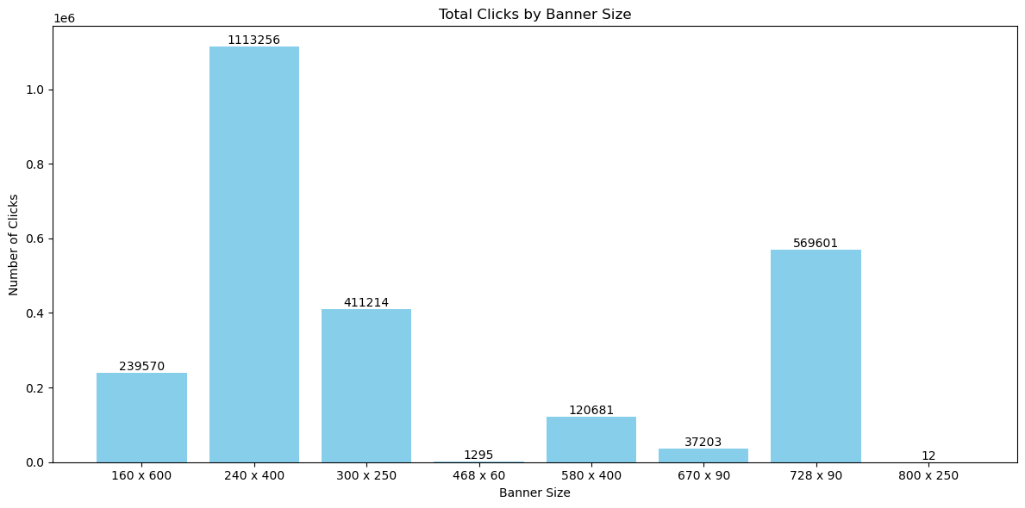
Banner Performance by Click Volume
Bar Graph
Analysis
Size doesn't equal performance: The largest size (800 x 250) has minimal clicks, while 240 x 400 excels.
Standard formats work: 728 x 90 (leaderboard) and 300 x 250 (medium rectangle) are industry standards performing well.
Extreme variations: There's over a 1000× difference between the best (240 x 400) and worst (800 x 250) performers.

Slide 10
Recommendations
Prioritize 240 x 400 — Allocate maximum budget and secure premium placements.
Discontinue 800 x 250 — ROI is too low to justify continued use.
Scale up 728 x 90 and 300 x 250 — Proven and consistent standard performers.
Focus 80% of banner budget on the top 3 performing sizes.
Investigate placement strategies that led to 240 x 400's success.
A/B test placement locations for underperforming sizes before full discontinuation.

Slide 11
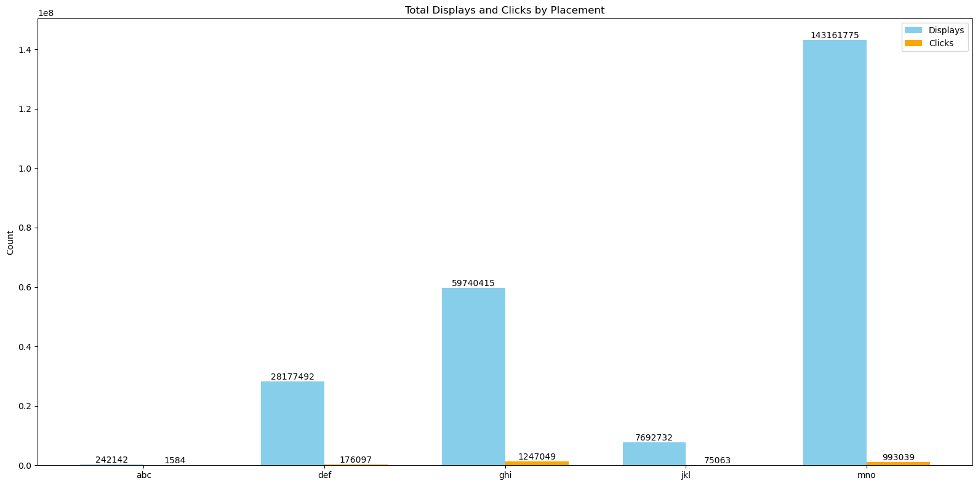
Placements vs Clicks & Displays
Grouped Bar Graph
Identifying the leader
Placement ‘mno’ clearly dominates both metrics, generating over 143 million displays and nearly 1 million clicks.
Placement ‘ghi’ is the second best performer in terms of both displays and clicks.
Placement ‘def’ ranks third across the metrics.
Placements ‘abc’ and ‘jkl’ show much lower performance in comparison, with minimal displays and clicks.

Slide 12
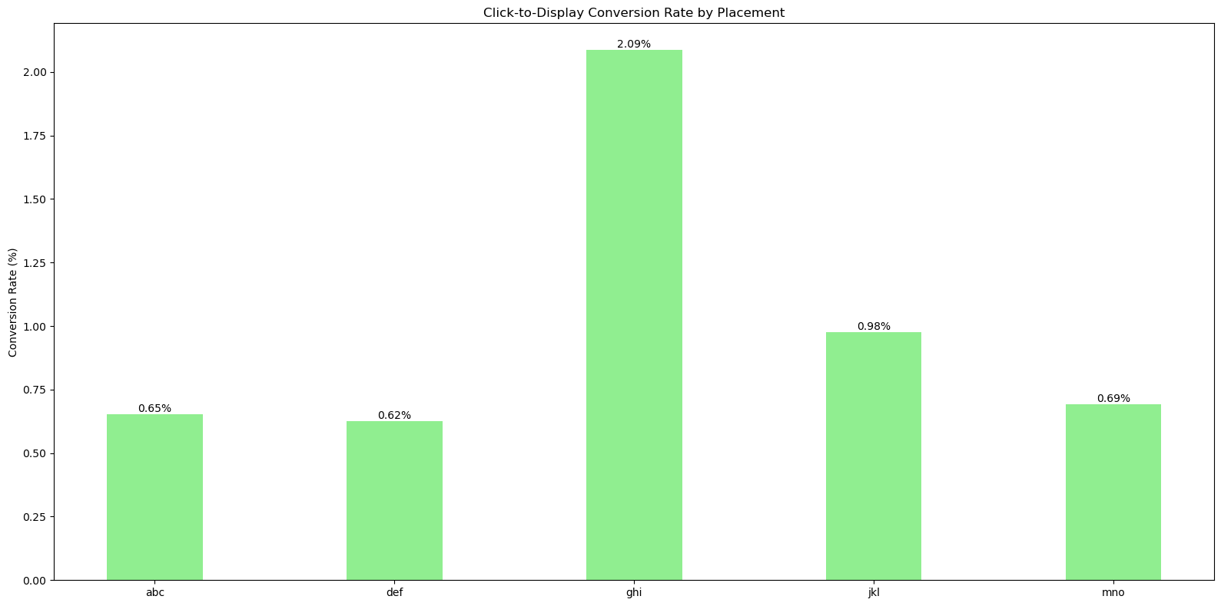
Conversion Rate by Placement
Bar Graph
Identifying the leader
While ’mno’ had by far the highest number of displays and clicks, ’ghi’ actually has the best conversion efficiency at 2.09% — more than double the rate of ‘mno’ (0.69%).
The ’ghi’ placement appears to be the most effective at converting displays into clicks, suggesting:
Better ad quality
Superior placement positioning
More targeted audience
The ’jkl’ placement also shows strong conversion efficiency at nearly 1%, which is notable given its relatively low volume in the previous chart.

Slide 13
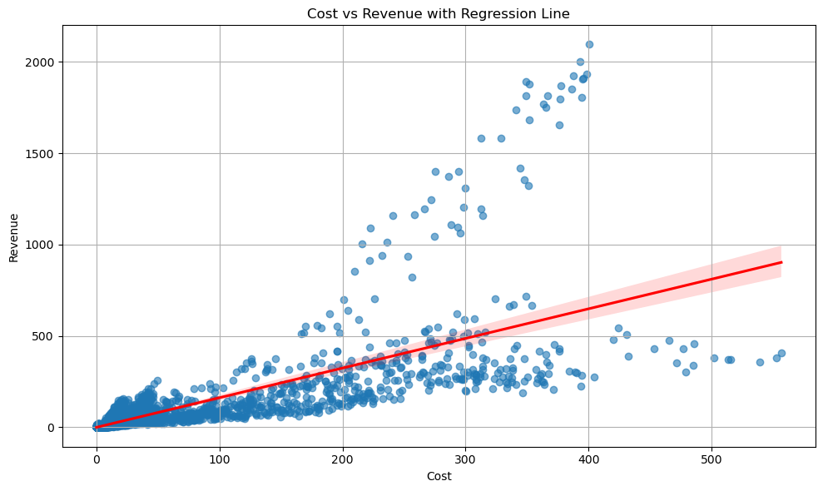
Ad spend vs Revenue Correlation
Scatter plot with regression line
Pearson Correlation Coefficient
Value: 0.76
Indicates a strong positive linear correlation between the cost of serving ads and the revenue generated from clicks.
Interpretation: As cost increases, revenue generally increases as well — but not in a perfectly linear manner.

Slide 14
Detailed Observations: Ad Spend vs Revenue
Regression Plot Observations:
The red line represents the linear regression line (line of best fit).
The shaded red region is the 95% confidence interval, reflecting uncertainty around the predicted regression line.
A tighter band would indicate higher certainty in the trend; here, the moderate spread suggests variability in the data.

Slide 15
Detailed Observations: Ad Spend vs Revenue
Scatter Distribution Insights:
The plot shows a wide spread of data points around the regression line.
This suggests that other variables may be influencing revenue beyond just cost:
Placement (e.g., website, app)
Banner size
User Engagement
Temporal Factors like month, day, or campaign duration

Slide 16
Detailed Observations: Ad Spend vs Revenue
Outliers and Clusters:
Some outlier points show high revenue at lower costs.
These could be examples of efficient campaigns or highly effective placements.

Slide 17
Average revenue generated per click
The average revenue per click across the entire campaign was approximately $0.111.
Breaking it down by campaign:
Campaign1 : $0.164
Campaign2 : $0.040
Campaign3 : $0.054
These values indicate a significant variation in campaign performance, with Campaign 1 generating much higher revenue per click compared to the others.

Slide 18
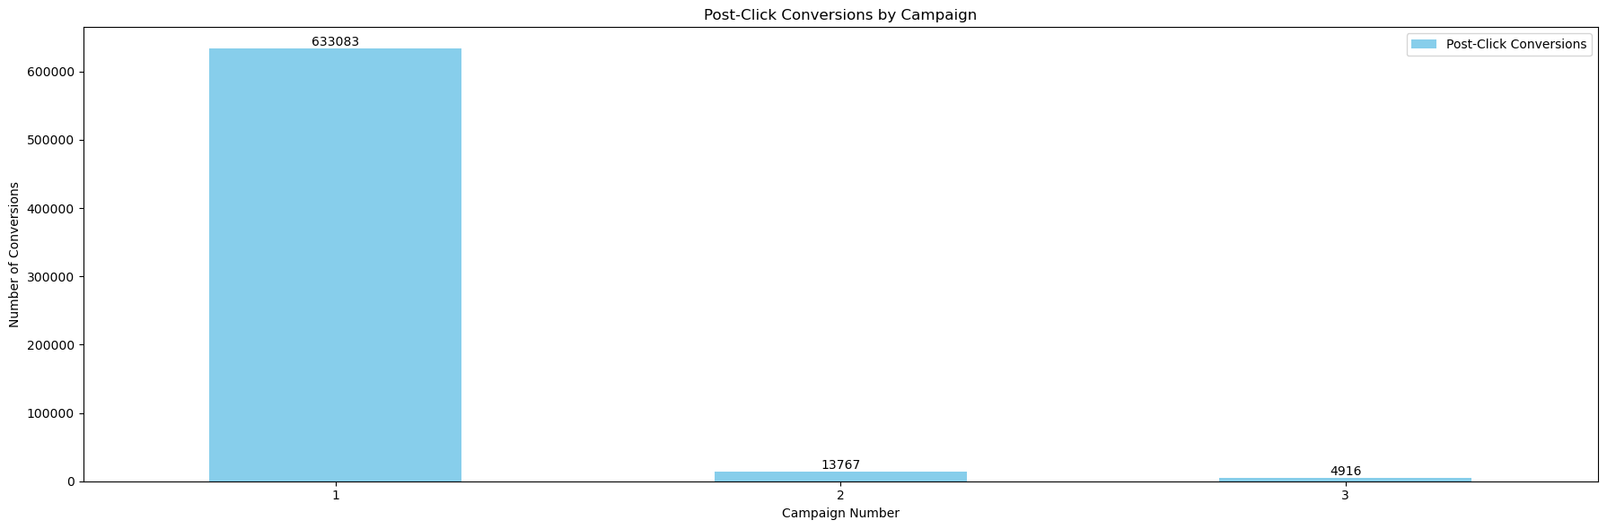
Campaigns vs post-click conversion rates
Bar Graph
Identifying the leader
The total number of post-click conversions for each campaign is as follows:
Campaign1: 633,083
Campaign2: 13,767
Campaign3: 4,916
Campaign 1 significantly outperformed the others in terms of post-click conversions, indicating a much higher conversion volume compared to Campaigns 2 and 3.

Slide 19
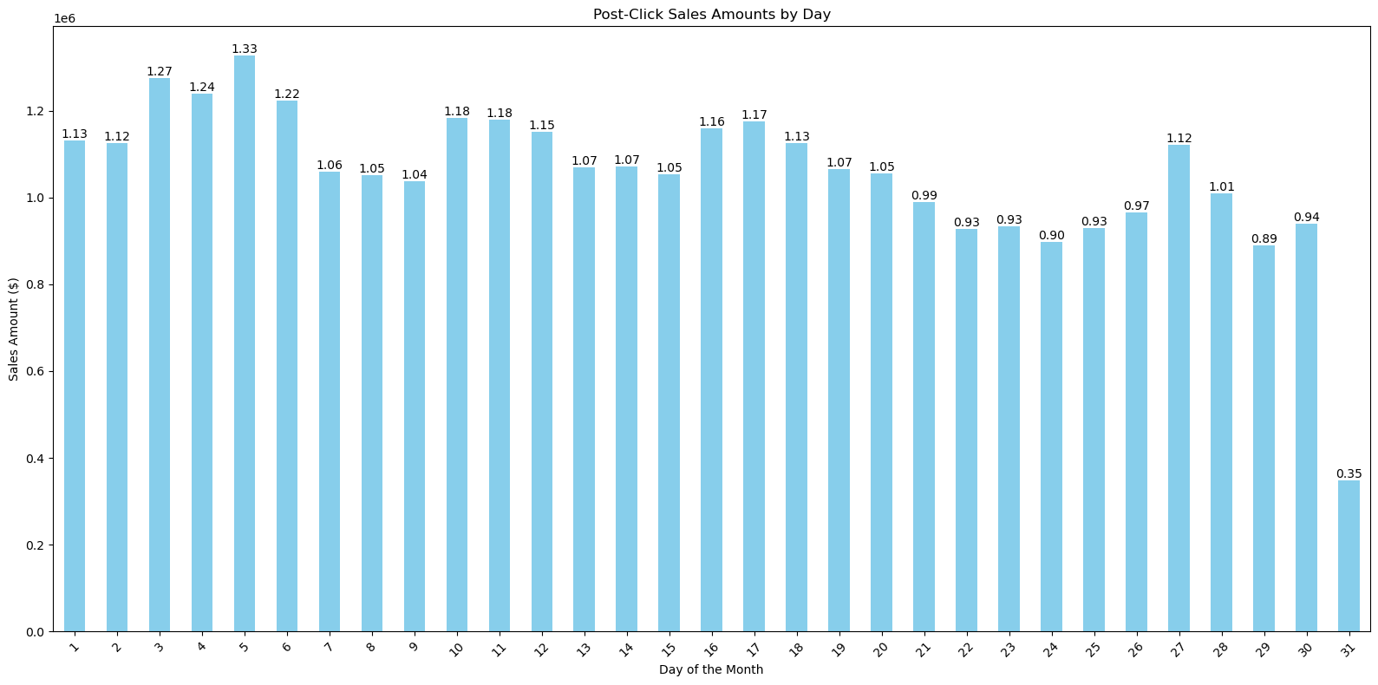
Post-Click Sales by Day
Bar Graph
Analysis
Budget Depletion Effect: The 19% performance drop from early to late month suggests budget constraints limit conversion opportunities.
Day 31 Anomaly: The dramatic drop to $0.35 million indicates insufficient data (appears in fewer months).
Conversion Consistency: 80% of days maintained above $1.0 million, demonstrating a reliable campaign foundation.

Slide 20
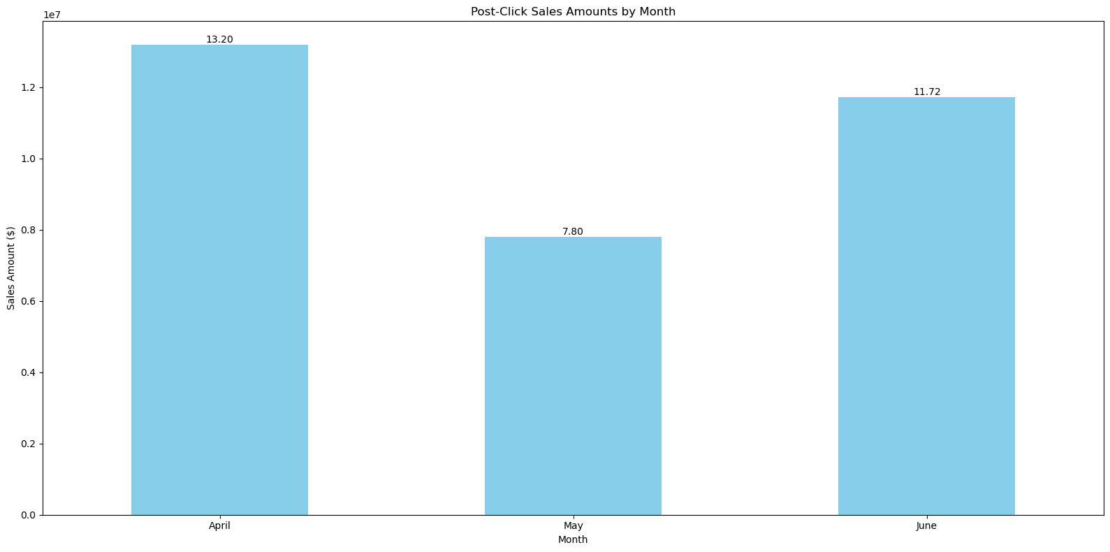
Post Click Sales by Month
Bar Graph
Analysis
Seasonal Pattern: Revenue fluctuated significantly from month to month, suggesting seasonal or campaign-specific factors influenced performance.
Recovery Strength: June’s performance rebounded strongly after May’s dip, indicating potential for future consistency.
Volatility: A 41% variance between months highlights the need to investigate contributing factors to these fluctuations.

Slide 21
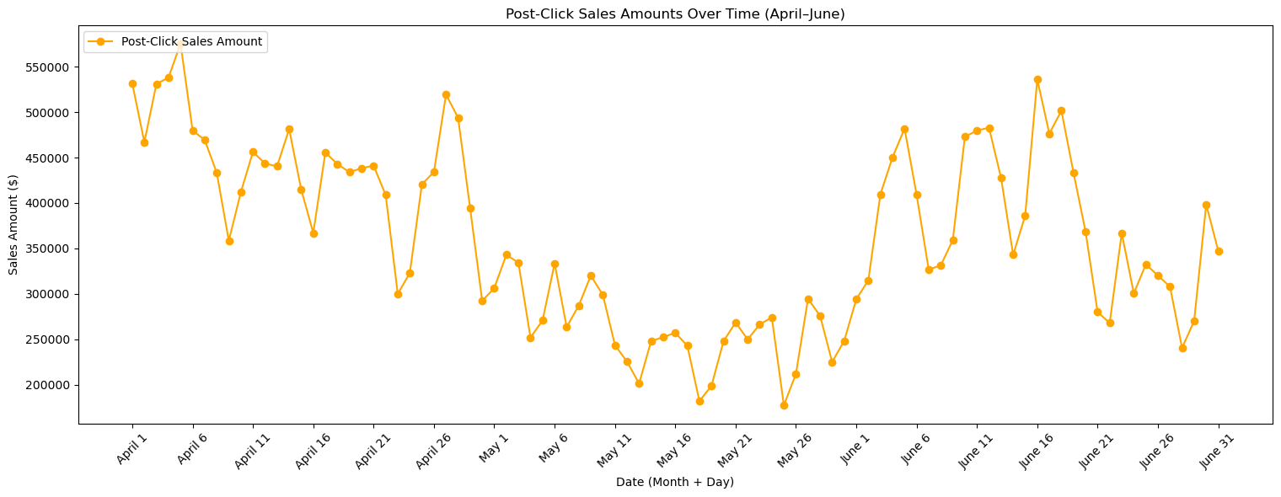
Post Click Sales Overtime
Line Plot
Analysis
April Decline: Clear downward trend observed from early April peaks to late April dips.
May Stagnation: Consistently low-performing period with limited fluctuation and minimal growth.
June Recovery: Strong upward trend with greater day-to-day variability and return to peak performance levels.

Slide 22
Recommendations
Implement smoother daily budget distribution to prevent late-month performance degradation.
Conduct a deep dive into May’s underperformance to identify internal or external factors (e.g., ad fatigue, audience shifts, seasonality).
Replicate successful April tactics (timing, creatives, targeting) in future campaigns, especially during high-potential months.
Use dynamic pacing and campaign tuning to control high fluctuations in April and June while maintaining strong performance levels.

Slide 23
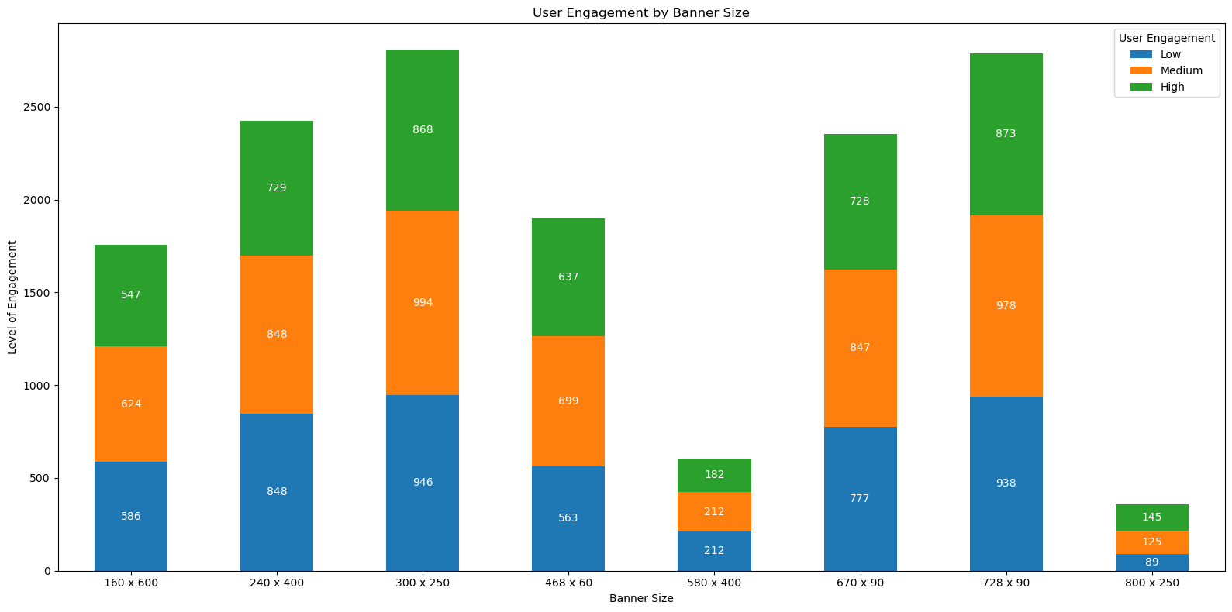
User Engagement by Banner Size
Stacked Bar Graph
Analysis
Size ≠ Success: Larger banners like 800×250 don’t correlate with higher engagement — in fact, they underperform.
Standard Formats Win: Industry-favorite dimensions like 300×250 and 728×90 benefit from optimal ad placements and user familiarity.
Quality Engagement Steady: High engagement numbers ranged from 145 to 873 across formats, indicating consistent user interest when banners resonate.

Slide 24
Detailed Observations
Standard banner sizes like 300×250 and 728×90 outperform oversized alternatives by 7–8×, confirming that familiarity and unobtrusiveness drive stronger user response.
Balanced Top Formats: The best-performing banners (300×250, 728×90) showed consistent engagement across all levels.
Medium Engagement Dominance: Most sizes skewed towards medium-level engagement, suggesting stronger interest than casual views, but not always deep interaction.
Underperformers: 580×400 (606 engagements) and 800×250 (359 engagements) demonstrated consistently poor performance across all engagement tiers.

Slide 25
Recommendations
Prioritize Investment: Direct 60–70% of your banner budget to the high-ROI formats: 300×250 and 728×90.
Cut Underperformers: Discontinue banners like 580×400 and 800×250, which deliver just ~10–15% of the engagement seen in top formats.
Support Formats: Retain 240×400 and 670×90 as secondary options to diversify inventory without hurting performance.
Test Creatives: Run A/B tests within top-performing formats to push high engagement conversions from ~30% to 40%+.

Slide 26
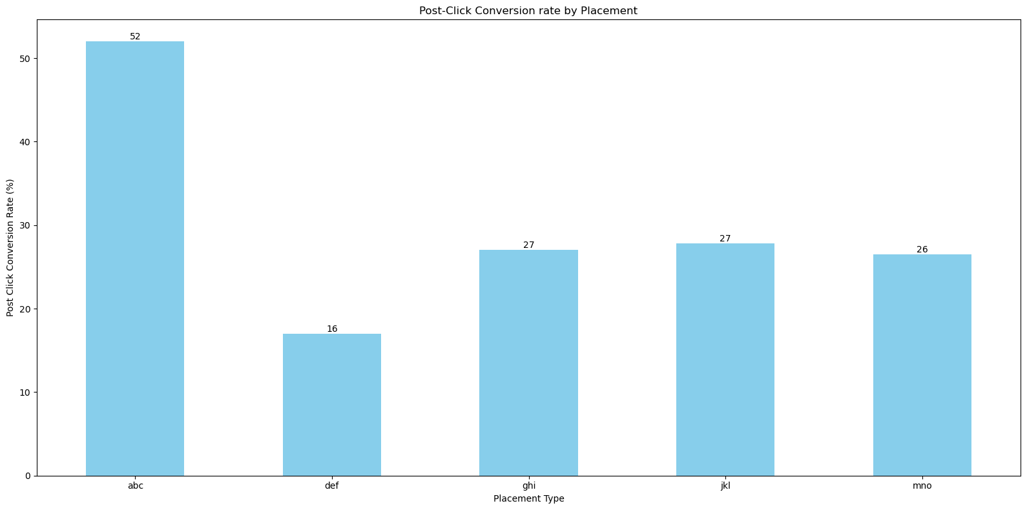
Placement vs Post Click Conversion Rate
Bar Graph
Identifying the Leader
‘abc’ placement recorded the highest post-click conversion rate at 52%.
This significantly outperformed the other placements:
‘ghi’ and ‘jkl’: 27% conversion rate each
‘mno’: 26% conversion rate
‘def’: 16% conversion rate (lowest performing placement)

Slide 27
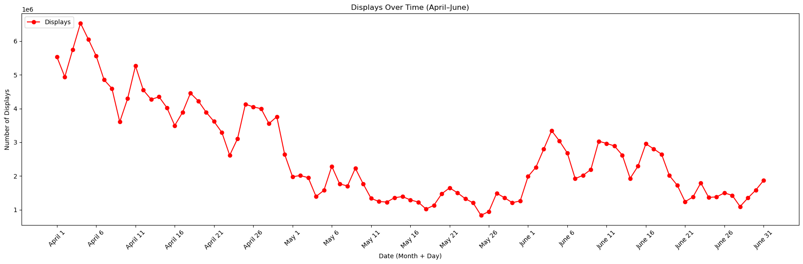
Analyzing Displays Overtime
Line Plot
Analysis
Early April Peak: Ad displays peaked around April 5 at 6.53 million, the highest in the campaign.
Steady Decline: From April 6 to May 20, displays consistently dropped, bottoming out at 832K — a 68% decline.
June Volatility: June saw a partial recovery with fluctuating volumes between 1.1M to 2.7M, but no sustained upward trend.

Slide 28
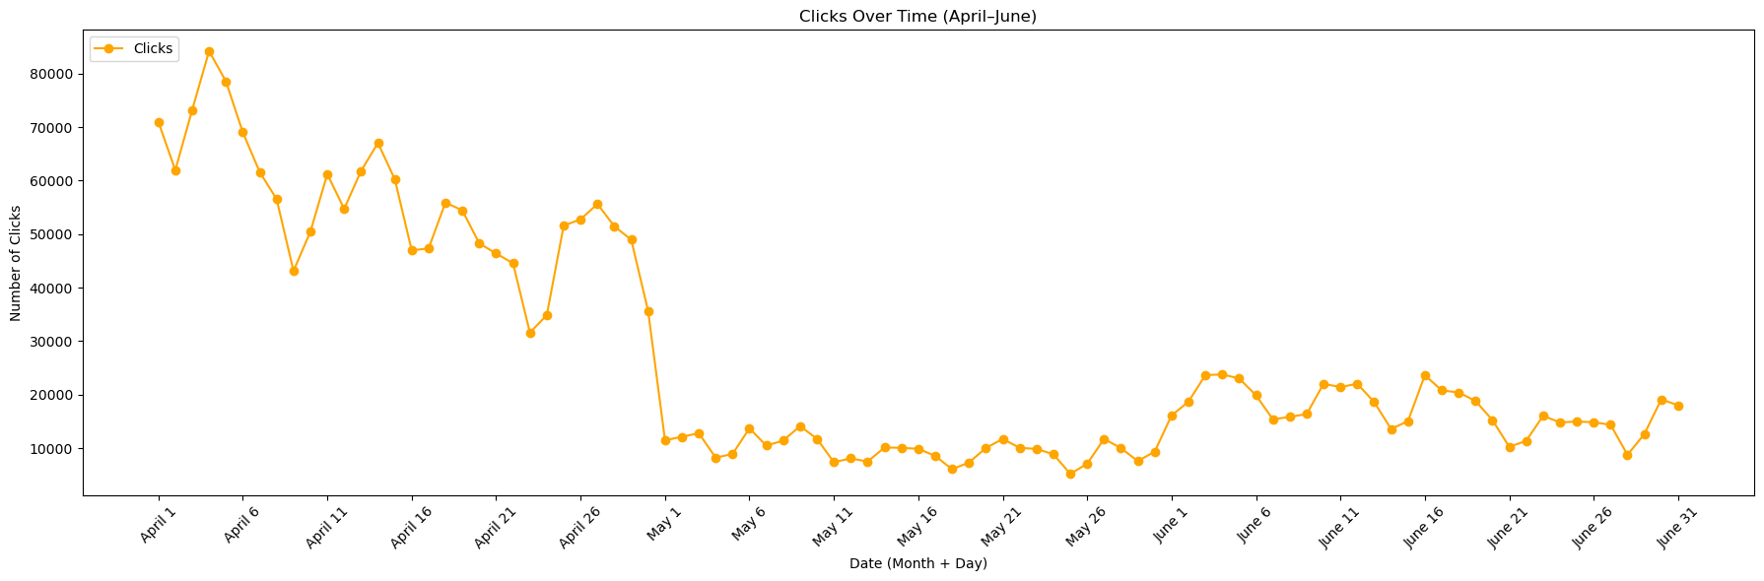
Analyzing Clicks Overtime
Line Plot
Analysis
Gradual Decline in April: Clicks steadily dropped to 35K–45K by mid-to-late April, with occasional short-term spikes.
Sharp Drop in May: Early May saw a steep decline in clicks, falling below 15K on most days — a clear dip in user engagement.
Stabilization in June: Click volumes stabilized between 5.2K and 26K, showing a modest, consistent recovery without major spikes.

Slide 29
Statistics: Displays and Clicks
Displays:
Mean displays per day: ~2.63 million
Median (50th percentile): ~2.19 million
Standard deviation: ~1.39 million (high variability)
Range: 832,830 (min) to 6.53 million (max)
Clicks:
Mean clicks per day: ~27,394
Median (50th percentile): ~16,385
Standard deviation: ~21,346 (indicating high variability)
Range: 5,214 (min) to 84,224 (max)

Slide 30
Recommendations
Displays:
Investigate causes for the sharp decline post-April 5 (e.g., budget changes, platform restrictions).
Implement sustained promotion efforts in late-April and May to avoid steep drop-offs.
Use performance-based scheduling to optimize display timings during high-visibility windows.
Clicks:
Investigate reasons for the sharp drop at the start of May, including campaign settings or external factors.
Consider reallocating ad budget or modifying targeting to improve click engagement.
Analyze high-performing April days for replicable patterns in creative or placement strategy.

Slide 31
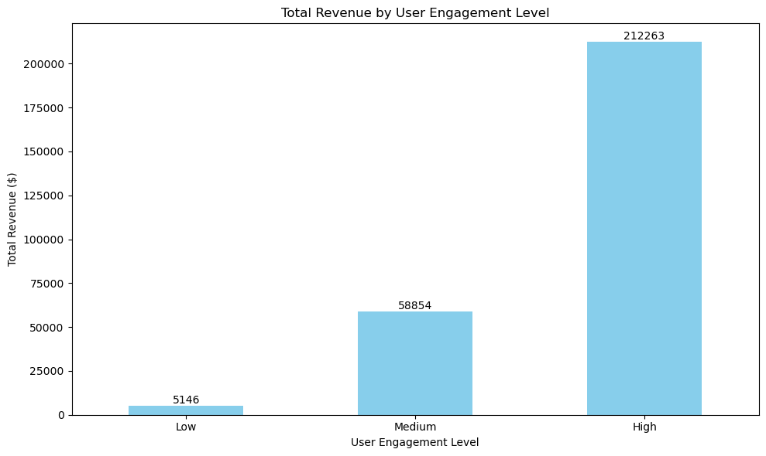
Correlation - Total Revenue & User Engagement Level
Bar Graph
Identifying the Correlation
A Pearson correlation coefficient of 0.96 indicates a very strong positive linear relationship.
This means that as user engagement increases, the revenue generated also increases significantly.
The trend is not just visual, but statistically validated.

Slide 32
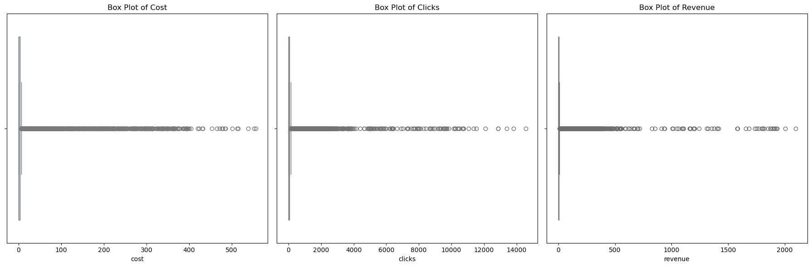
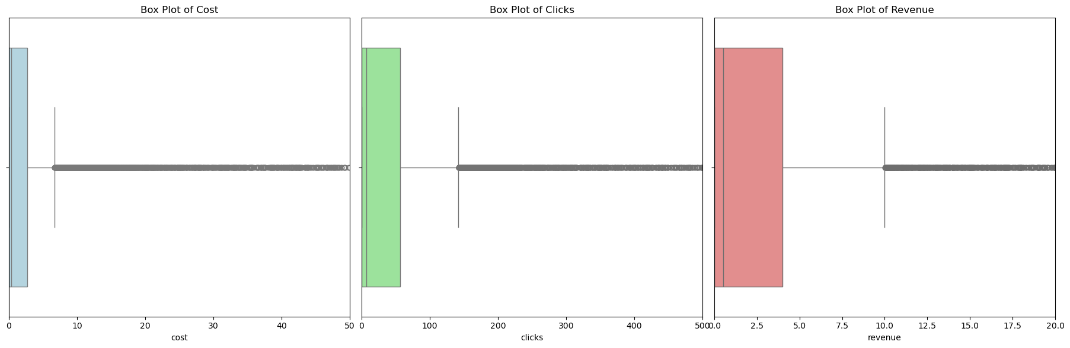
Outliers in Cost, Clicks & Revenue
Original Box Plot
Zoomed in Box Plot

Slide 33
Outliers in Cost, Clicks & Revenue
Cost Outliers
Clicks Outliers
Revenue Outliers
Total Campaigns Affected: 2,427 campaigns
Presence: Multiple high-cost outliers are visible above the upper whisker.
Impact: These high-cost campaigns may be driving up overall advertising spend without proportional returns.
Implications: Indicates potential budget allocation inefficiencies or premium placement strategies. Requires immediate investigation for cost optimization opportunities.
Total Campaigns Affected: 2,208 campaigns
Presence: Numerous outliers exist on the high end, with some campaigns generating significantly more clicks than the typical range.
Significance: High-click outliers could indicate viral content, optimal targeting, or seasonal spikes.
Implications: Represents potential success patterns for replication across other campaigns.
Total Campaigns Affected: 2,456 campaigns
Presence: Several high-revenue outliers are visible above the upper whisker.
Potential: These outliers represent either highly successful campaigns or data anomalies requiring validation.
Implications: Strong correlation with cost outliers suggests either high-investment/high-return strategies or inefficient spending. Critical for identifying top-performing campaign characteristics.

Slide 34
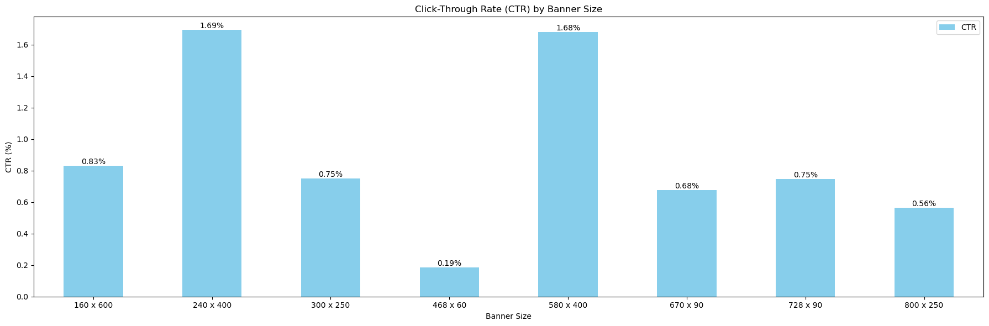
Click-Through Rate vs Banner Size
Bar Graph
Analysis
Vertical banners outperform: Tall formats like 240x400 and 580x400 have the highest CTRs.
Banner blindness: 468x60 format has very low engagement, likely due to user desensitization.
Skyscraper format is reliable: 160x600 performs well across campaigns.
Medium rectangle (300x250) provides average performance.
Leaderboard results vary: 728x90 performs reasonably, while 800x250 lags behind.
Horizontal formats underperform: Smaller wide banners like 670x90 show weaker results.

Slide 35
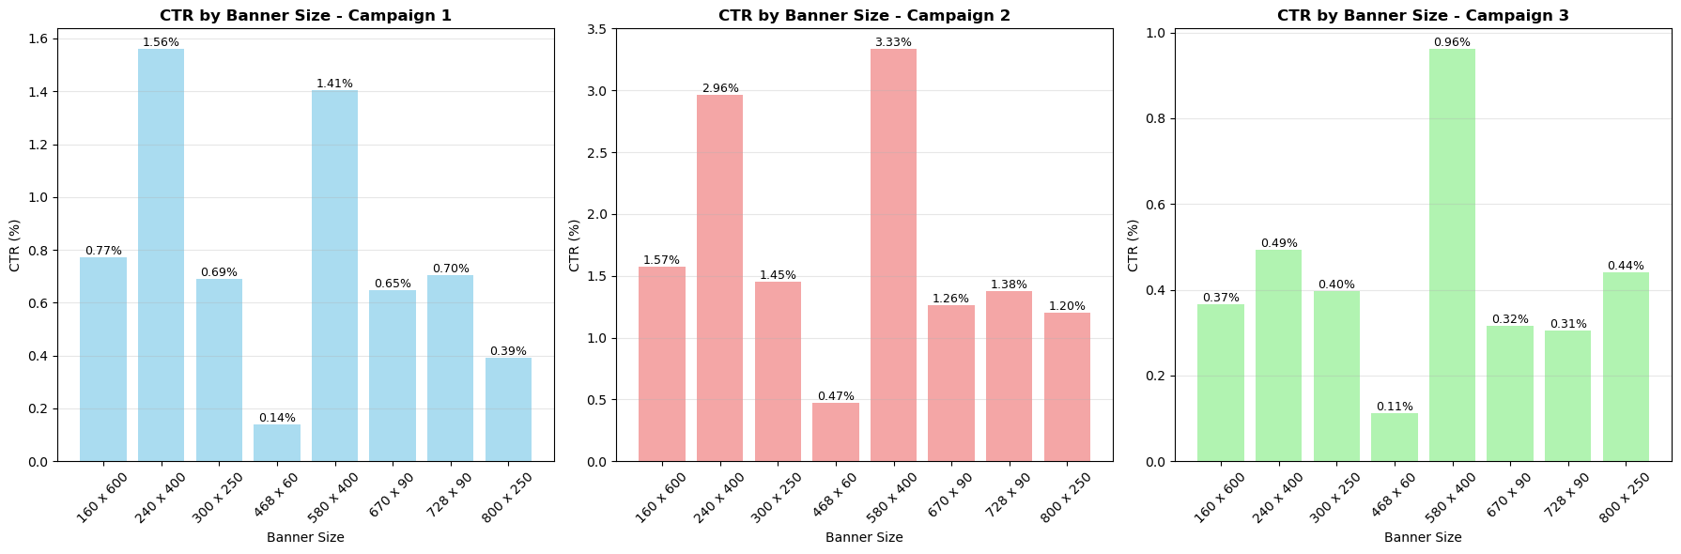
CTR vs Banner Size by Campaign
Bar Graph
Analysis
Campaign1:
CTR Range: 0.14% - 1.56%
Top Performer: 240x400 (1.56%)
Worst Performer: 468x60 (0.14%)
Spread: 11.1× difference
Campaign2:
CTR Range: 0.47% - 3.33%
Top Performer: 580x400 (3.33%)
Worst Performer: 468x60 (0.47%)
Spread: 7.1× difference
Campaign3:
CTR Range: 0.11% - 0.96%
Top Performer: 580x400 (0.96%)
Worst Performer: 468x60 (0.11%)
Spread: 8.7× difference

Slide 36
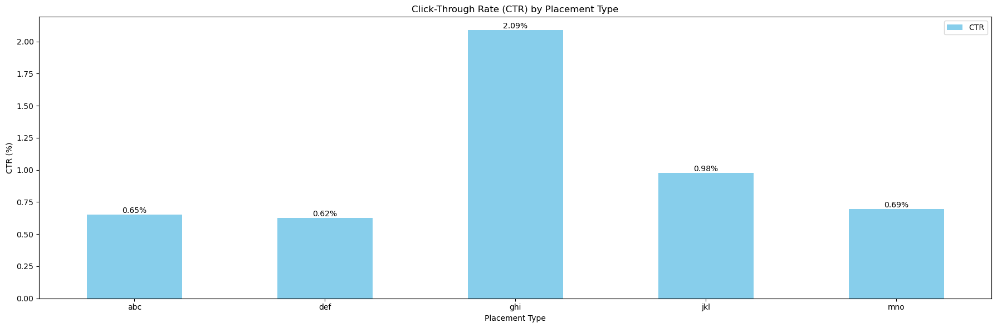
Click Through Rate vs Placement
Bar Graph
Analysis
The "ghi" placement achieves a 2.09% CTR, representing a 3.4× performance advantage over the lowest-performing placement "def" (0.62%). This dramatic difference suggests significant variations in placement quality, visibility, or user engagement context.
The data reveals two distinct performance clusters:
High-impact cluster: ghi (2.09%) and jkl (0.98%) – premium placements.
Standard cluster: abc, def, mno (0.62% - 0.69%) – baseline placements with minimum variation.

Slide 37
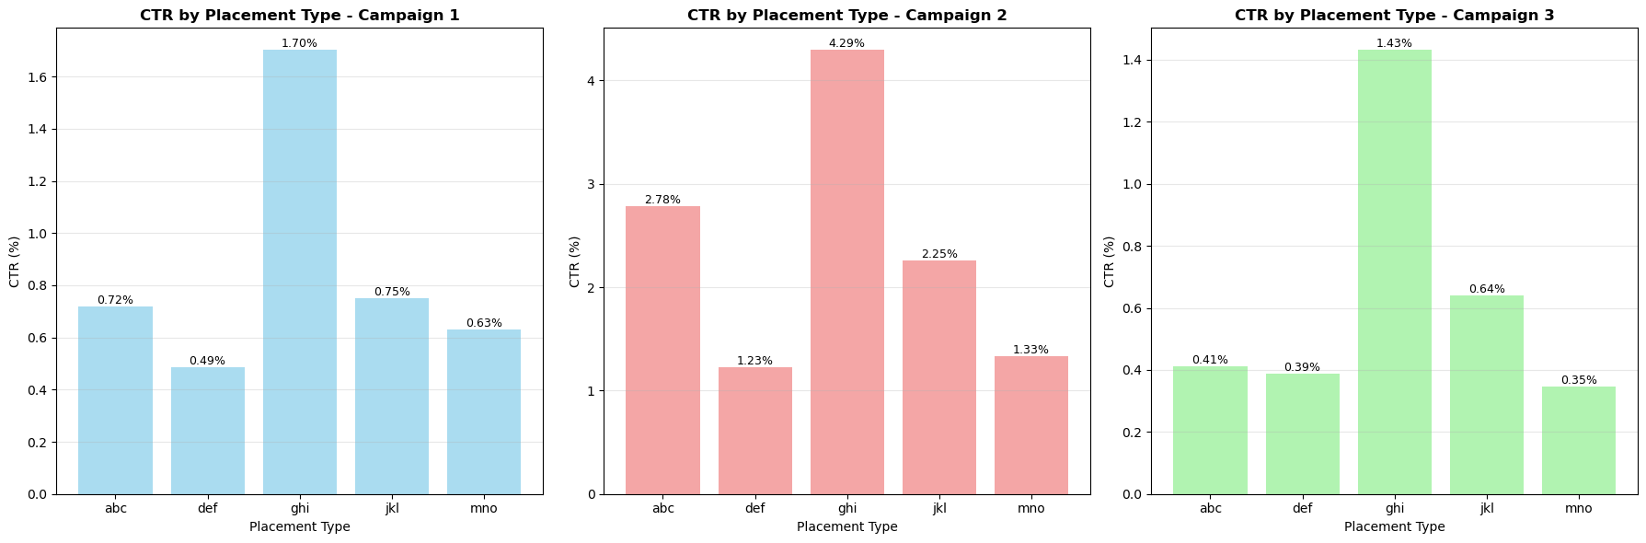
CTR vs Placement by Campaign
Bar Graph
Analysis
Campaign 1
CTR Range: 0.49% - 1.70%
Top Performer: ghi (1.70% CTR)
Worst Performer: def (0.49% CTR)
Performance Spread: 3.5x difference
Campaign 2
CTR Range: 1.23% - 4.29%
Top Performer: ghi (4.29% CTR)
Worst Performer: def (1.23% CTR)
Performance Spread: 3.5x difference
Campaign 3
CTR Range: 0.35% - 1.43%
Top Performer: ghi (1.43% CTR)
Worst Performer: mno (0.35% CTR)
Performance Spread: 4.1x difference

Slide 38
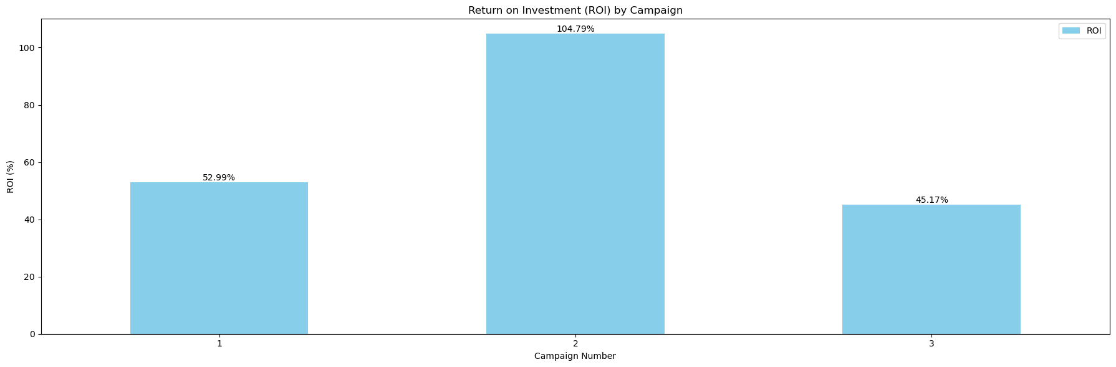
ROI by Campaign
Bar Graph
Analysis
Campaign 1 Performs Moderately: ROI of 52.99% indicates solid but average performance, with $1.53 return per $1 spent.
Campaign 2 Leads ROI: With an ROI of 104.79%, Campaign 2 delivers exceptional returns, generating $2.05 per $1 spent, and is the only campaign to exceed 100% ROI.
Campaign 3 Underperforms: Lowest ROI at 45.17%, yielding $1.45 per $1, and lags 59.64% behind Campaign 2 — revealing major optimization potential.

Slide 39
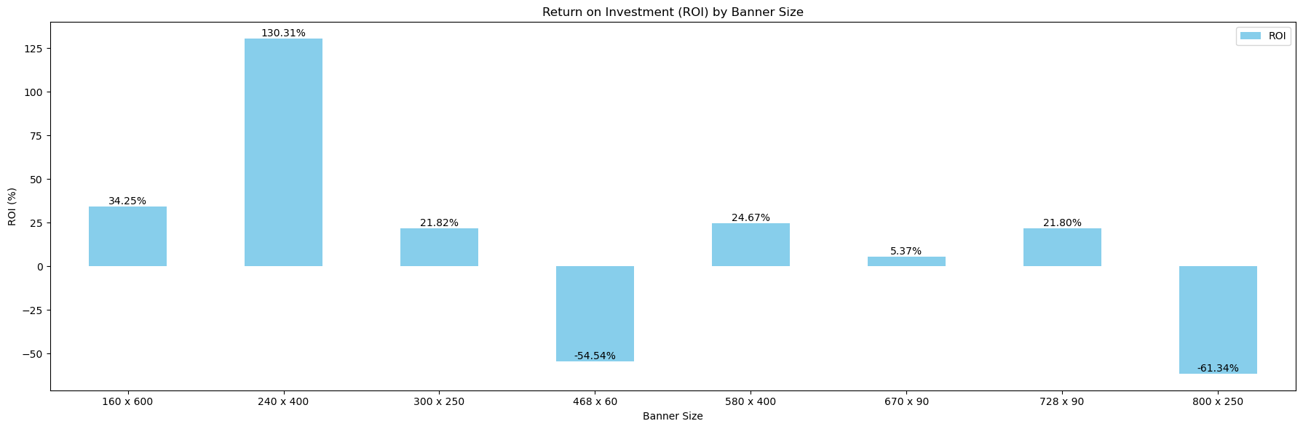
ROI by Banner Size
Bar Graph
Analysis
Top Performer
240x400 banner leads with 130.31% ROI,
3.8× higher than next best (160x600)
Only format exceeding 100% ROI
Moderate to Poor Performance:
160x600: 34.25% (second-best)
580x400, 300x250, 728x90: ~22–25% ROI
670x90: 5.37% (barely profitable)
Loss-Making Formats:
468x60: -54.54% ROI → loses $0.55 per $
1800x250: -61.34% ROI → worst performer, loses $0.61 per $1
Gap between best and worst: 191.65%, showing banner size matters significantly.

Slide 40
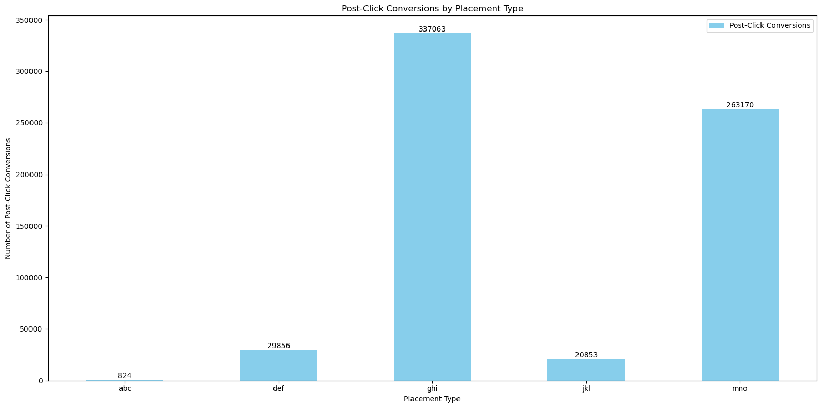
Post-Click Conversions by Placement
Bar Graph
Analysis
Top Performers:
GHI: 337,063 conversions — highest, strong engagement and conversion potential
MNO: 263,170 conversions — second-best, solid performance
Moderate Performers:
DEF: 29,856 conversions — decent, but far behind leaders
JKL: 20,853 conversions — modest results
Underperformer:
ABC: Only 824 conversions — minimal impact, needs strategic re-evaluation

Slide 41
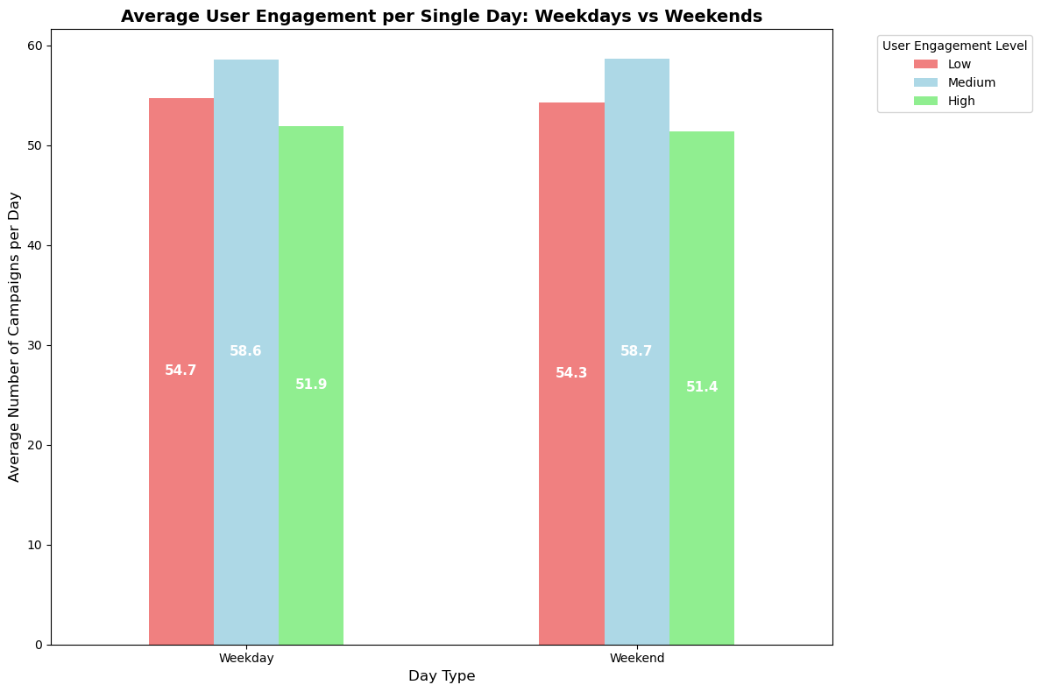
User Engagement Levels – Weekends vs Weekdays
Bar Graph
Analysis
Consistent Engagement:
User engagement levels are virtually identical on weekdays and weekends — no significant variation observed.
Low Engagement Users:
Slight dip on weekends (−0.7 campaigns, 1.3% decrease).
Medium & High Engagement Users:
Medium: Practically unchanged (+0.1 campaigns)
High: Minor drop (−0.5 campaigns, 0.9% decrease)
Insight: Day of the week has minimal impact on user engagement across all levels.

Slide 42
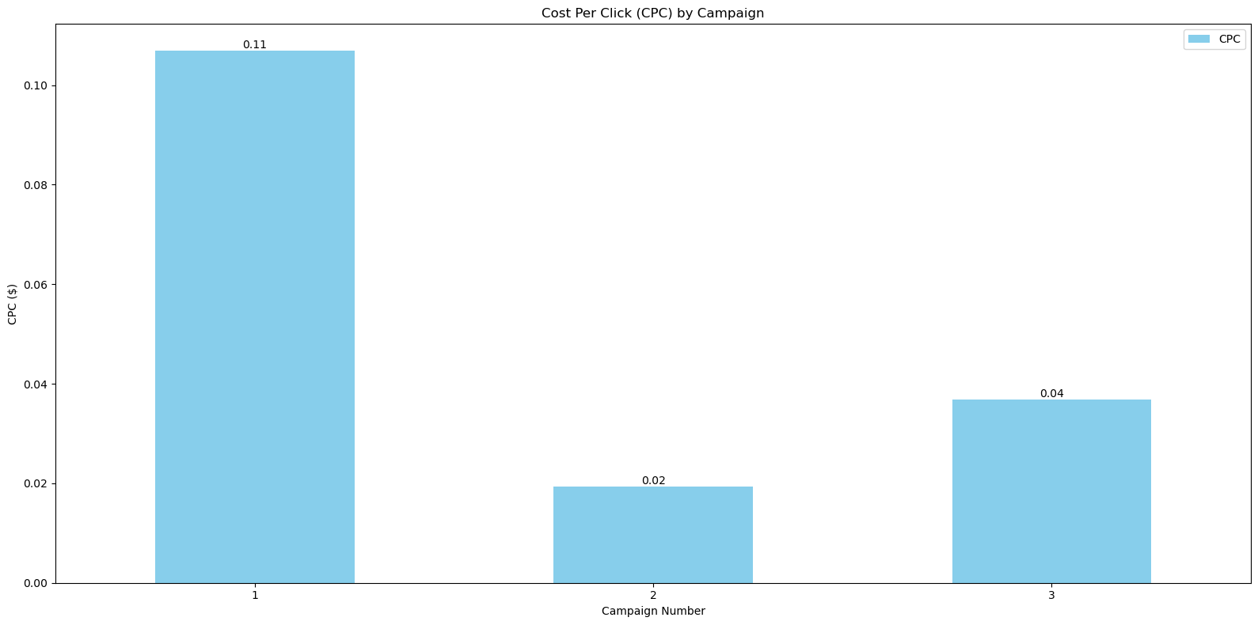
Cost per Click by Campaign
Bar Graph
Analysis
Significant CPC Variation:
CPC ranges from $0.02 to $0.11, reflecting a 450% cost difference across campaigns.
Campaign Insights:
Campaign 1: Highest CPC ($0.11), 5.5× more expensive than Campaign 2 — needs urgent optimization
Campaign 2: Lowest CPC ($0.02) — cost benchmark and most efficient
Campaign 3: Moderate CPC ($0.04) — 2× more costly than Campaign 2, but still manageable
Insight: Clear cost optimization opportunities exist, with Campaign 2 setting the efficiency standard.

Slide 43
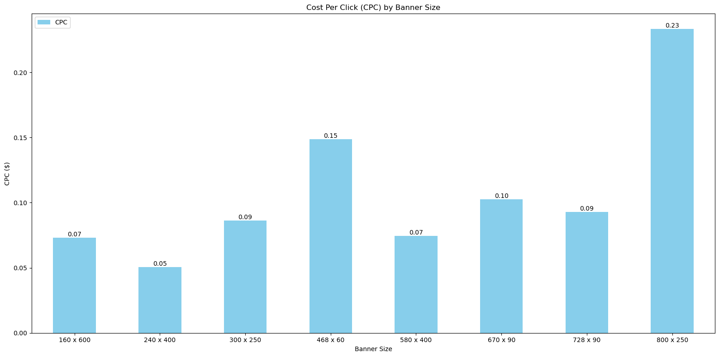
Cost per Click by Banner Size
Bar Graph
Analysis
Wide CPC Variation: CPC ranges from $0.05 to $0.23 — a 360% difference, highlighting significant cost efficiency gaps across banner formats.
Most Cost-Efficient Banners:
240×400: $0.05 — lowest CPC, top-performing format
160×600 & 580×400: $0.07 — highly efficient
Moderately Priced Banners:
300×250 & 728×90: $0.09 — balanced efficiency
670×90: $0.10 — slightly higher, still acceptable
Premium-Priced Banners:
468×60: $0.15 — moderately expensive
800×250: $0.23 — most expensive, needs careful ROI analysis
Insight: Prioritizing low-CPC formats like 240×400 can improve overall cost efficiency.

Slide 44
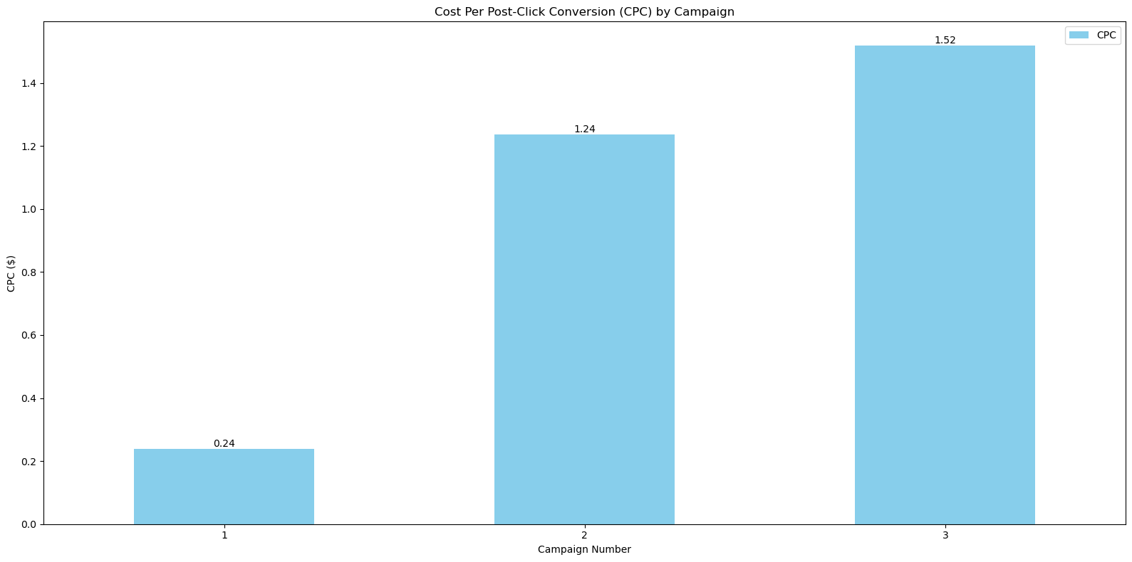
Cost per Post Click Conversion by Campaign
Bar Graph
Analysis
Campaign 1 – Most Efficient:
Highest CPC ($0.11) but lowest conversion cost ($0.24) — shows high-quality traffic and strong engagement.
Campaign 2 – Misleading Efficiency:
Lowest CPC ($0.02) but high conversion cost ($1.24) — inefficient conversions, likely due to poor user intent or landing page.
Campaign 3 – Least Efficient:
Mid CPC ($0.04) with highest conversion cost ($1.52) — worst performance, suggesting wasted spend on low-quality traffic.

Slide 45
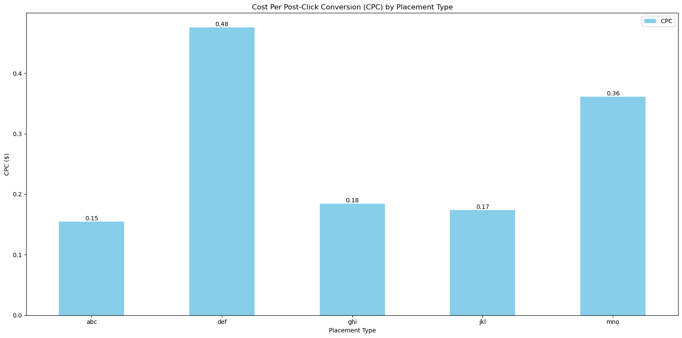
Cost per Post Click Conversion by Placement Type
Bar Graph
Analysis
Wide Efficiency Gap:
Conversion costs range from $0.15 to $0.48, showing a 220% variation across placements.
Top Performers:
ABC ($0.15) : Most efficient
JKL ($0.17) and GHI ($0.18) : Strong ROI and competitive costs
Underperformers:
MNO ($0.36) : Needs optimization
DEF ($0.48) : Least efficient, requires urgent review

Slide 46
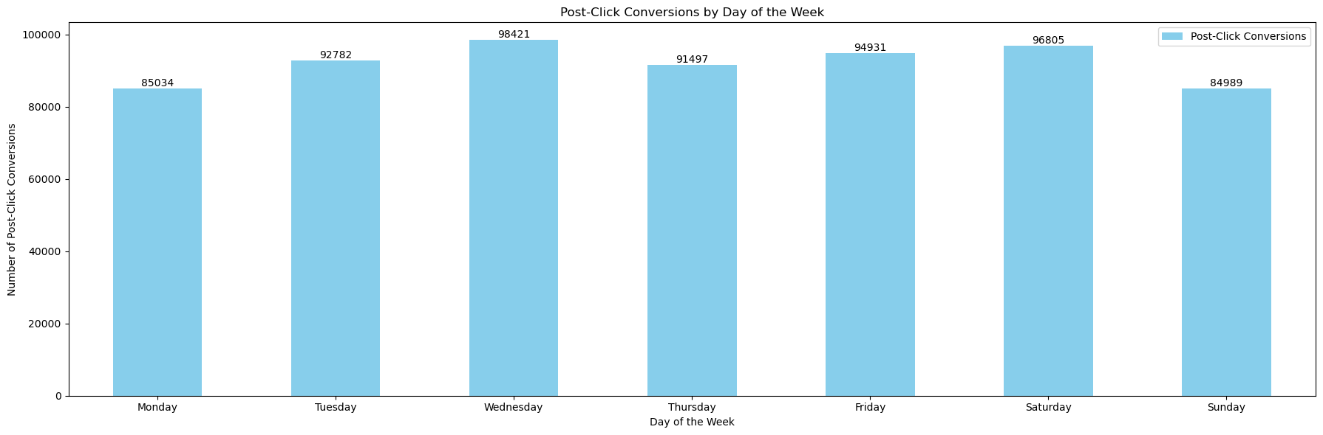
Post Click Conversion by Day of the Week
Bar Graph
Analysis
Mid-Week Dominance: Wednesday's leadership suggests users reach peak decision-making capacity mid-week, likely due to accumulated research and reduced Monday startup friction.
Weekend Split: Saturday's strong performance (96,805) versus Sunday’s weakness (84,989) indicates a sharp behavioral shift as users transition from leisure to preparation mode.
Monday Motivation Gap: The 13.6% deficit on Monday suggests lower user engagement and purchase intent at week’s start.

Slide 47
Recommendations
Budget Reallocation: Shift 20–25% more budget to Wednesday–Friday window to capitalize on peak conversion periods
Weekend Strategy: Maintain Saturday investment while reducing Sunday spend by 15–20%
Monday Recovery: Implement awareness-focused campaigns on Monday to prime users for mid-week conversions
Dynamic Bidding: Increase bid multipliers by 15% on Wednesday/Saturday, decrease by 10% on Sunday/Monday
Performance Variance Insight: A 15.8% gap between best (Wednesday) and worst (Sunday) days indicates significant optimization opportunity through day-of-week targeting adjustments.

Slide 48
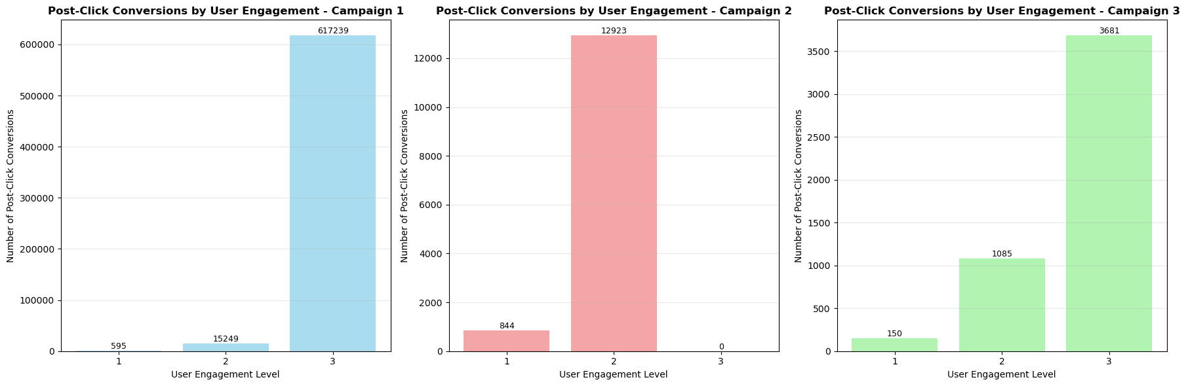
Post Click Conversions vs User Engagement by Campaign
Bar Graph
Analysis
Campaign Effectiveness Hierarchy: Campaign 1 massively outperforms others, generating 46x more conversions than Campaign 2 and 129x more than Campaign 3.
Engagement Optimization Gaps: Campaign 2's zero high-engagement conversions represent a critical failure to monetize the most valuable user segment.
Scaling Patterns: Only Campaign 1 successfully converts engagement into substantial revenue, while Campaigns 2 and 3 show limited scalability.

Slide 49
Recommendations
Resource Reallocation: Shift 70–80% of budget to Campaign 1 strategy, given its superior high-engagement performance.
Campaign 2 Redesign: Investigate why high-engagement users abandon Campaign 2; add premium elements or deeper value propositions.
Campaign 3 Enhancement: Scale successful linear model with increased investment to boost baseline performance.
Engagement Targeting: Focus Campaign 1 on high-engagement audiences, Campaign 2 on medium-engagement, and retire underperforming strategies.
High-engagement users drive 94% of Campaign 1’s success, indicating premium positioning and sophisticated targeting yield exponentially better results than broad-appeal strategies.

Slide 50

Thank You.
Prepared by Tanush Garg · July 2025
"Without data, you're just another person with an opinion." — W. Edwards Deming

